Slide 1
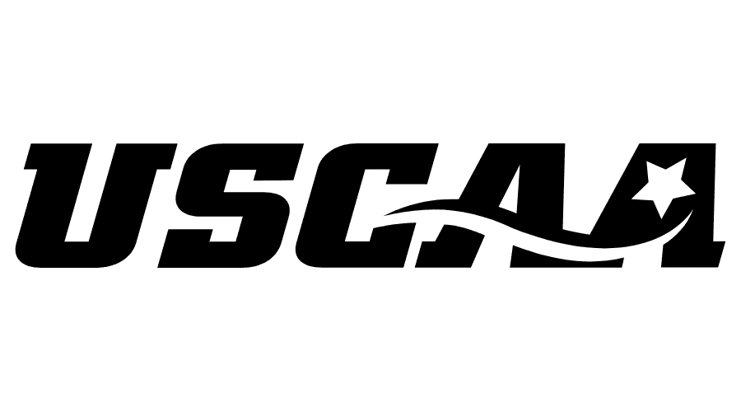

NIL Town Hall
September 30, 2021

Slide 2
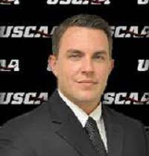
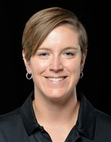
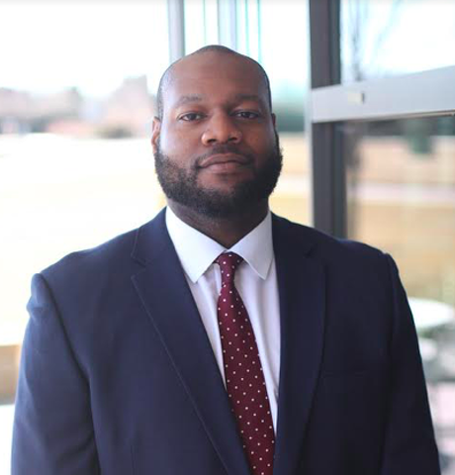
Panel Commentary
Matthew Simms, Special Advisor to USCAA Board
BJ Bertges, USCAA COO
Chima Okoli, Special Counsel for USCAA

Slide 3

What is NIL?
Name, Image, Likeness
Profiting from use of your name, image or likeness
Endorsements, marketing/sponsorship, promotional/advertising

Slide 4
History of NIL
September 2019
California is the first state to introduce legislation to provide pathways to endorsements for student-athletes
October 2019
NCAA Board agree to modernize their amateur rules to permit NIL
April 2020
NCAA crafts new legislation to go into effect in January of 2021

Slide 5
History of NIL
June 2020
Florida passes state laws for NIL to begin July of 2021 – creates urgency amongst states to address the issue
July 2020
NCAA President implores help from Congress; meanwhile some student-athletes threaten boycott and formation of players’ associations
All governing bodies are asked to provide feedback on NIL rules
September 2020
Congressional representatives introduce a federal bill that would allow NIL deals

Slide 6
History of NIL
December 2020
New legislation introduced that would allow for some NIL deals and create an anti-trust exemption to protect NCAA
Supreme Court reviews federal judge ruling in anti-trust lawsuit
Again – new legislation introduced that impacts NCAA control on amateurism
Jan/Feb 2021
NCAA puts delay on NIL vote
Meanwhile, a new bill is introduced that would provide for unrestricted market for college athlete endorsement deals
June 2021
Conference commissioners in NCAA proposed new plan that would allow individual schools to be responsible for creating their own NIL policies
No federal law imminent

Slide 7
History of NIL
June 2021
Supreme Court rules against NCAA anti-trust appeal
June 2021
NCAA Board of Directors adopt a temporary rule change to allow for institutional policies on NIL activity
NAIA opens doors on NIL rules
July 2021
July 1 – NCAA new rules and state laws went into effect, permitting NIL activity
Later in the summer – USCAA loosens restrictions on NIL activity

Slide 8
State Laws allowing NIL activity
States with laws in place
Alabama -- Passed: April 2021. Goes into effect: July 1, 2021.
Arizona -- Passed: March 2021. Goes into effect: July 23, 2021.
Arkansas - Passed: April 2021. Goes into effect: Jan. 1, 2022.
California -- Passed: September 2019. Goes into effect: Jan. 1, 2023.
Colorado -- Passed: March 2020. Goes into effect: Jan. 1, 2023.
Connecticut -- Passed: June 2021. Goes into effect: July 1, 2021.
Florida -- Passed: June 2020. Goes into effect: July 1, 2021.
Georgia -- Passed: May 2021. Goes into effect: July 1, 2021.
Illinois -- Passed: June 2021. Goes into effect: July 1, 2021.
Kentucky -- Passed: June 2021. Goes into effect: July 1, 2021.
Louisiana -- Passed: July 2021. Goes into effect: July 1, 2021.
Maryland -- Passed: May 2021. Goes into effect: July 1, 2023.
Michigan -- Passed: December 2020. Goes into effect: Dec. 31, 2022.
Mississippi -- Passed: April 2021. Goes into effect: July 1, 2021.
Missouri -- Passed: July 2021. Goes into effect: Aug. 28, 2021.
Montana -- Passed: April 2021. Goes into effect: June 1, 2023.
Nebraska -- Passed: July 2020. Goes into effect: No later than July 1, 2023 (schools can implement new policy at any time).
Nevada -- Passed: June 2021. Goes into effect: Jan. 1, 2022.
New Jersey -- Passed: September 2020. Goes into effect: September 2025.
New Mexico -- Passed: April 2021. Goes into effect: July 1, 2021.
North Carolina -- Signed: July 2021. Goes into effect: July 2, 2021.
Ohio -- Signed: June 2021. Goes into effect: July 1, 2021.
Oklahoma -- Passed: May 2021. Goes into effect: July 1, 2023 (schools can implement new policy at any time).
Oregon -- Passed: June 2021. Goes into effect: July 1, 2021.
Pennsylvania -- Passed: June 2021. Goes into effect: June 30, 2021.
South Carolina -- Passed: May 2021. Goes into effect: July 1, 2022.
Tennessee -- Passed: May 2021. Effective date: Jan. 1, 2022.
Texas -- Passed: June 2021. Effective date: July 1, 2021.
States with bills in legislative process
There are still some states with bills actively moving through the legislative process: Massachusetts (2022), New York (2021), Rhode Island (2022).

Slide 9
Framework for State Laws
What is allowed VS. What is not allowed
Student-athletes have the right to earn endorsement deals and schools cannot restrict them from earning market value compensation (except in specific circumstances – Prohibited categories and sponsorship conflicts)
Students can now have agents, financial advisors and legal representation
Schools retain right to academic standards and codes of conduct
Schools retain right to their trademarks/logos
Deals can’t be made with promise to attend
Institutions may not serve as third party agents for deals/endorsements/sponsorship
Schools cannot pull scholarships from students because they sign deals
Students cannot sign deals whose terms conflict with major sponsorships from the organization
Prohibited items including adult entertainment, alcohol, tobacco, gambling, controlled substances, etc.

Slide 10
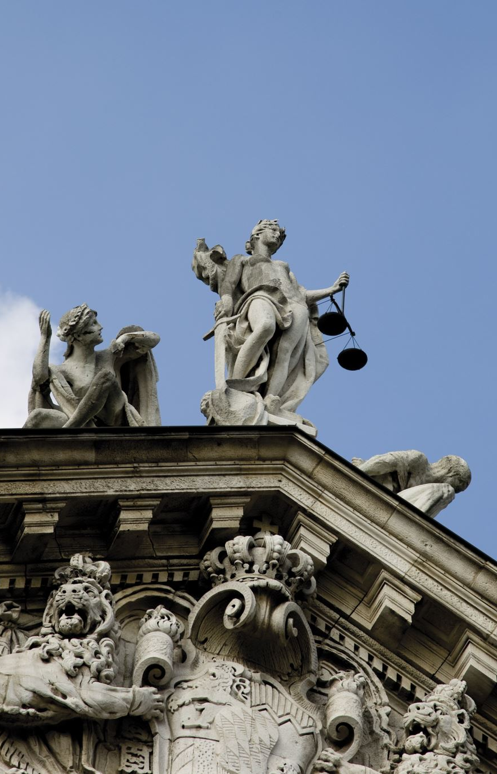
Federal law
Shown Here:
Introduced in Senate (06/18/2020)
Fairness in Collegiate Athletics Act
This bill requires an intercollegiate athletic association to establish a policy that permits a student athlete to earn compensation from a third party for the use of the name, image, or likeness of the athlete and to obtain professional representation with respect to such compensation.
An association must establish rules and programs to administer such policy, including reporting requirements for such compensation and necessary measures to preserve the amateur status of student athletes.

Slide 11
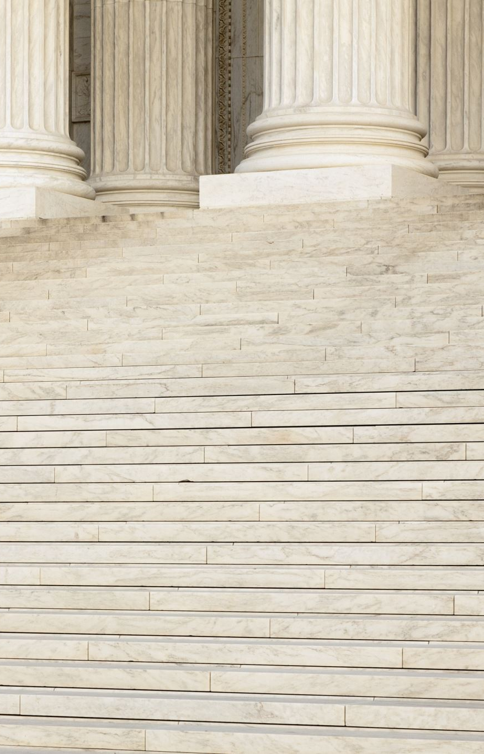
Other federal laws proposed
S 4004 Student Athlete Level Playing Field Act
S 8382 Collegiage Athlete Compensation Rights Act
S 5003 College Athlete Bill of Rights
S 5062 Amateur athletes Protection and Compensation Act of 2021
S 414 College Athlete Economic Freedom Act.

Slide 12

Resources
History of NIL
  https://www.espn.com/college-sports/story/_/id/31086019/everything-need-know-ncaa-nil-debate
State and Federal Laws
  https://businessofcollegesports.com/tracker-name-image-and-likeness-legislation-by-state/?amp

Slide 13
NCAA Current policy
NAIA Current policy
Individuals can engage in NIL activities that are consistent with the law of the state where the school is located. Colleges and universities may be a resource for state law questions.
College athletes who attend a school in a state without an NIL law can engage in this type of activity without violating NCAA rules related to name, image and likeness.
Individuals can use a professional services provider for NIL activities.
Student-athletes should report NIL activities consistent with state law or school and conference requirements to their school.
Unrestricted NIL activity permitted.
Reporting requirements

Slide 14

USCAA Current policy
Reprieve from Bylaw 24.5.7
24.5.7 Amateur Status Only amateur students shall be eligible to participate in a given sport. A student-athlete would not be eligible if they have violated any of the following guidelines.
Article 4: Receiving payment for any public appearance or promotion of product/business, if the appearance makes reference to the student’s intercollegiate athletic participation in any sport or the school in which the student competes.

Slide 15
USCAA Current policy
While the USCAA works to create new policies, student-athletes and institutions should abide by the following:
Comply with respective state laws surrounding NIL.
Institutions must develop reporting procedures (required in most states) for student-athletes to report any NIL appearances and/or contracts.
Institutions and states have the right to limit advertising categories (largely considered vice categories – gambling, tobacco, alcohol, etc.). Institutions should comply with state laws when looking to prohibit advertising categories.
Institutions must determine if a student-athlete may use institutional marks or appear in school apparel when participating in NIL appearances.
Still no pay to play!

Slide 16

Future forward…
The NCAA has asked Congress to consider adopting a federal policy on NIL that would make all such activity consistent among states.
How restrictive should NIL be? What activities should it permit or not
Do institutions/conference have the right to approve/disapprove of any such action by student-athletes?
What does this mean for amateurism?
How does this affect small colleges?

Slide 17
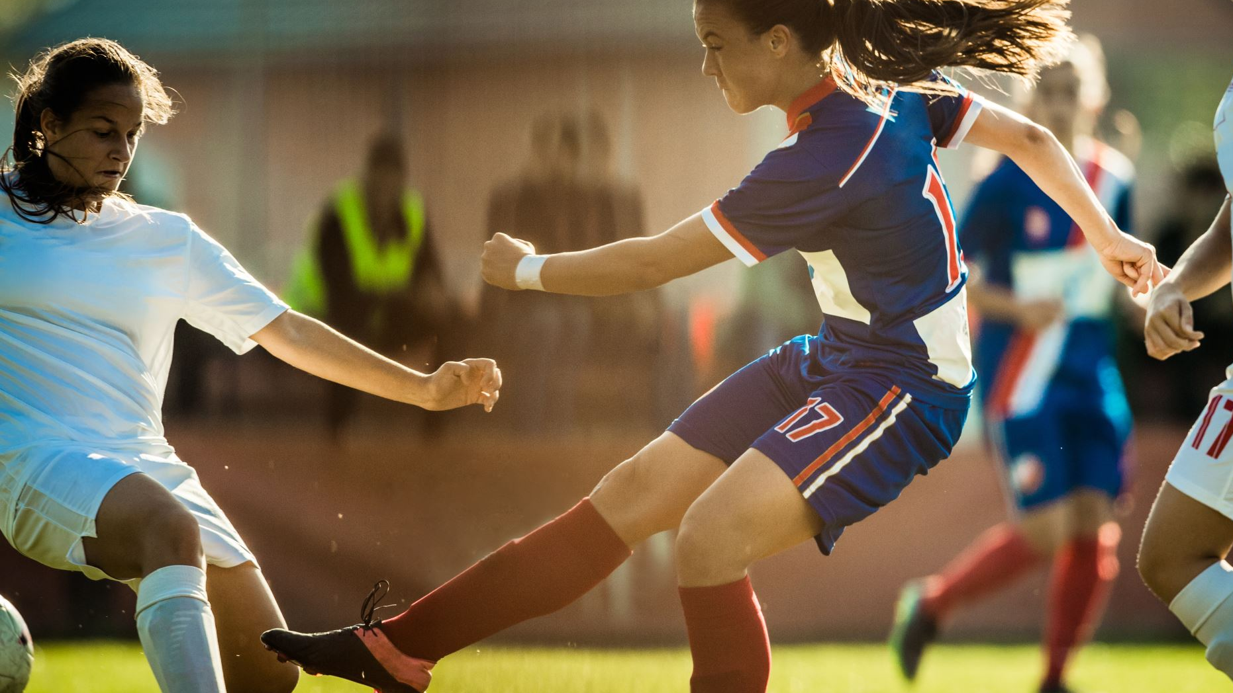
USCAA Goals & Timeline
Aggregate responses and concerns from USCAA membership
Adopt Steering Committee for NIL activities
Have Mr. Okoli review committee recommendations for NIL legislation

Slide 18
Questions from the membership
My question is: what do SIDs have to be aware of regarding NIL? We follow our athletes on social media, and see a lot more than we probably should, so I imagine we could be the first to know about a sponsorship, etc. Is there anything we need to do to “report” or take note of it?
Karina Graziani
Associate Director of Athletics for Sports Communications & Recruiting
Carlow University Department of Athletics

Slide 19
Questions from the membership
Do our USCAA Student-Athletes have the same privileges as a NCAA Student-Athletes?
Carlos Figueroa
Men's Soccer Head Coach
The King's College NYC

Slide 20

Questions from the membership
Remarks from attendees??

Slide 21

Closing REmarks
Chima Okoli
Matthew Simms

